Slide 1
Mrs. A’s Class Expectations ….
Please find your name on the desks. This will be your assigned seat unless told otherwise.
Thank you!

Slide 2
Where you will sit …
Please find your names on the desks. It will be color coded. This will be your assigned seat unless told otherwise. Your color is
Red
Yellow
Green or
Blue.

Slide 3
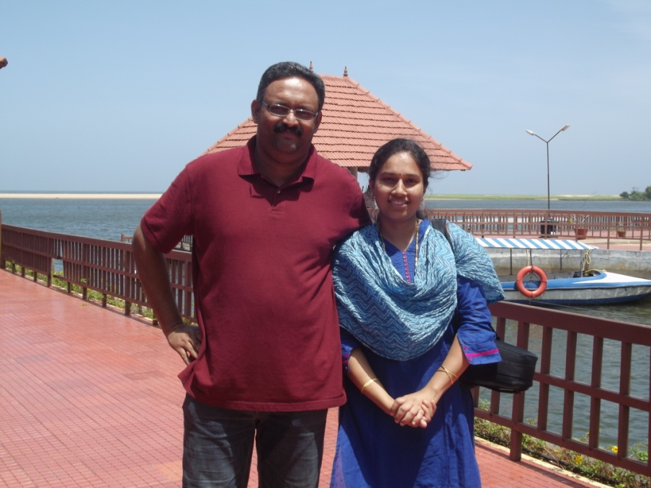

About me…

Slide 4
A bit more…
I hail from India. I now live in Huntersville, so don’t worry about commute ;)
I am a bit of an artist and a nature lover.
I am also an Engineer ( you are in safe hands)
I believe in every one of you, You are going to be brilliant ( only remember to follow the rules ☺. ) Now it is your turn…

Slide 5
Will I treat you fairly…
Always, count on it.

Slide 6
What will I be doing this year ?..
Learn all about variables..
Lots about functions
A bit of geometry
and also about trends ( not only fashion trends, but that’s a thought!)

Slide 7
How will I be graded?
Formal grades – tests, projects ( These will be stored in the portfolio for future reference)
Informal grades- Homework completion, quizzes, technology grades.( These have to be submitted for grading, late submission will get 10 points lesser for each day delayed.) Minimum of 50 % will be awarded.
If absent, you can look up the missed work and homework on my Weebly account, the work submitted the next working day will not be penalized.
The grades will be updated weekly by Friday evening. Please use Powerschool to stay informed.

Slide 8
Rules in the classroom.
  1. Stay in your assigned seat at all times, unless directed otherwise
  2. Respect others, their opinions, things.
  3. Follow all procedures and policies.
  4. Be prepared.
  Choosing to follow the rules will result in
  A stress free working environment,
  A pleasant and secure place to be.

Slide 9
Not Choosing to follow the rules will result in
  Step 1- name on board, verbal warning
  Step 2- Student and teacher conference.
  Step 3- Parent Communication
  Step 4- time out
  Step 5- Bounced to another class.
  Please note that all these steps could be by passed by the teacher if the case was severe.
  This will be reset weekly.

Slide 10
Classroom Contract for Ms. Anu
Guidelines and Procedures
Why have procedures?
  If you are opening a combination lock, you need to select your combination according to the lock manufacturer.
  To place a call, you need to enter the numbers in the right order.
  These procedures will guide you to success in this class.

Slide 11
Guideline 1
On entering the classroom, go to your assigned seat, get prepared for the class (make sure you have the notebook, homework out, and pencil if needed).
Note: If you do not have a pencil, get a pencil from the pencil cup by giving collateral ( shoe, purse, hat …). At the end of the class, return the pencil and take your collateral.
Work on the Warm up.
On finishing the warm-up, stay quiet and you may read a book.

Slide 12
Warm-up samples
The warm- up will be in the following format.
Mondays- 3 Questions
Tuesdays- 2 Questions/ Video of the week.
Wednesdays- Keeping skills sharp
Thursdays- Mental Math
Fridays- Fun Facts/ Weekly reflection.

Slide 13
Guideline 2-
Bring all the things needed for the class
Scissors
Glue stick
Notebook
Chrome book
And take them with you when leaving the class.

Slide 14
Guideline 3
Follow all directions the first time given to you.

Slide 15

Guideline 4
Treat every person with respect and dignity. Every person matters in this class. It is a safe zone. There will be no idea that will be laughed at.

Slide 16
Guideline 5
Follow all the school rules in the Handbook.

Slide 17
Infraction sheet- Action form.
If you get the action form, read it, fill the details, your action to avoid infraction. Hold on to it till the end of class, submit it in the bin on your way out.
This will be filed in your folder for future reference.( Yes, Everyone has a folder!)

Slide 18
Action form details
Name: Date: Block:
Infraction:
What is causing the problem?
How will I solve this problem?
Student signature:

Slide 19
Extreme cases
Any student who uses profanity or is involved in a fight or damages school property will be given an office referral right away.

Slide 20
Classroom Procedures
Please enter the room quietly ( voice level 0)
Please take out your Chrome, write down the homework on your calendar.
30 your Chrome
Write down the homework in Your calendar, note deadlines
Review the agenda
Start your Warm-up.

Slide 21

When you are tardy..
Enter quietly
Place the excuse in my basket
If unexcused, sign the list on the desk.
Get seated and start work.

Slide 22
Getting your attention.
I require your attention if I am in the front of the class with a raised hand.
ring the bell.
In either cases, turn and face the teacher quietly and raise your hand.

Slide 23
Paper heading
On all the work that is submitted you should have your
Name
Date
Block
written ,to be accepted for grading.

Slide 24
Notebook
Use a pen or a pencil to write in your notebook.
The first page should be your name and the subject.
The second page should be the Index.
Always number the pages at the bottom right hand corner.
Maintain the index as noted by the teacher or when entering a new unit.
Every day, start on the first available space in the book. Remember that paper is made from Trees. ☺
Date your work and keep it tidy and organized.
Your journal will be collected on Fridays for a journal check.
Keep good care of it, do not lose it.

Slide 25
Missing Assignments/Homework
Any work that is missing will need to be brought to school the next day. Every missed day will get you 10 points lesser.
Late work needs to be submitted in the late bin in the back of the room.
If you were absent, it is your responsibility to submit the work the next working day. The instructions will be uploaded in the Weebly. Tutoring will be given on Thursday morning from 7:30- 8:45. Email me to RSVP.

Slide 26
Finish Classwork early…
In case you finish the Classwork early
  Complete the Exit ticket
  Complete the Homework
  Work on Ten-marks assignment/jam session- this will count toward your technology assignment.

Slide 27
To get my attention
For emergency Bathroom visit- raise index finger
For a pencil- raise first two fingers.
For any question in the subject- open your book on the desk.

Slide 28

Technology Care
The computers are always to be either in your book bag or…
The computers are to be in a 30 deg position, if not in use.
Phones should not be seen in the classroom. They should be put away.

Slide 29

Turning in papers
If the papers are being collected in the class. Then place your paper on the desk to your left (if facing the board), right ( if facing the windows.)
If/ When you receive a paper, put your paper on top of the stack and pass the stack.
I will come by and collect all the stacks.

Slide 30
Classroom discussions
Please participate in all the discussions. The more you talk Math, you will understand better.
Make all questions and comments relevant to the topic being discussed.
Any other question should be noted down for later discussion.
Listen when some one is sharing be it the teacher or another student.
When doing group work, your voices should be in Level 1- Whisper voice. Only the person you are talking to should hear you.

Slide 31
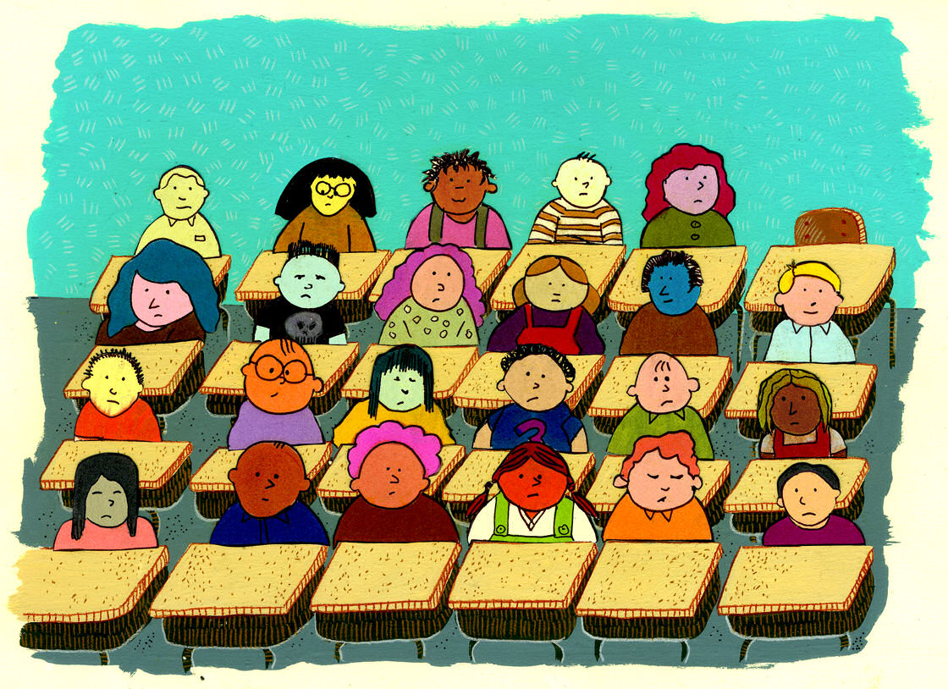
Moving around the room
You should ask permission to move around the room.
Do not move out of your space during a class discussion unless it is an emergency.

Slide 32
Class dismissal
The teacher dismisses the class not the bell .
Do not start packing unless the teacher asks you to do so.
Wait till the teacher officially dismisses you with a “ Have a nice Day”.

Slide 33

Announcements
All school wide announcements should be heard. So all students should not talk but listen to the announcements.

Slide 34

Special procedures
There will be special procedures added as needed like
Fire Drill
Lockdown
Special guests
Substitute teacher
Progress reports

Slide 35

Jobs in class
There will be jobs in the classroom. This position could be volunteered for, or selected randomly by the teacher.
The jobs will be rotated every week on Mondays.

Slide 36

Teacher’s promise
I will always
  Be on time and on task and prepared.
  Expect the best from you.
  Believe in you.

